Slide 1
SGOS MultiStation
How to set for multistation mode

Slide 2
Introduction
Demand:
To expand the testing resource, or split a DUT testing into 2 station.
Implement:
A server-client python program using TCP/IP protocol to play a role which deliver test values, control signal and binning summary between stations.
SGOS made a modification to adapt the Master-Slave mode so that it could send and receive information by using the server-client program.

Slide 3
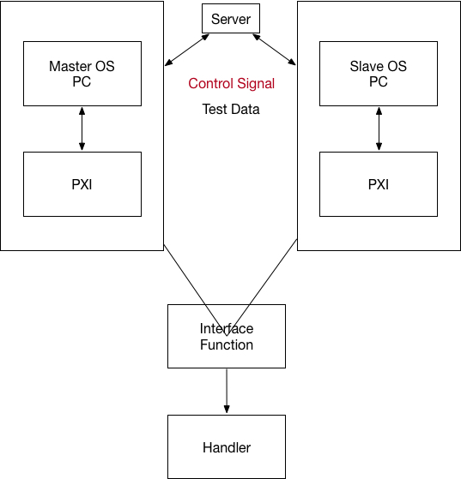
MultiStation Structure
Notes:
各台測試機間藉由中介Server程式傳遞Control Signal, Test Data, Binning Summary
Control Signal可以讓Slave OS只需按下Start, 其餘動作皆與Master OS自動同步動作
各站Test Data, Binning Summary會傳至server彙整, 由Master OS接收後列印至datalog

Slide 4
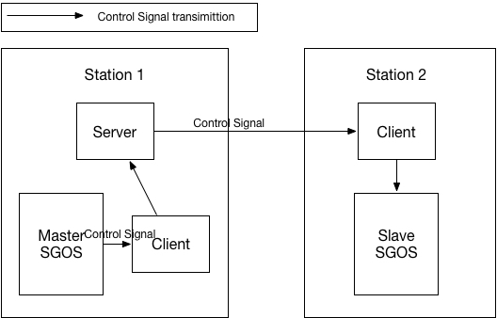
Interactive Flow
Control Signal
Control Signal could let the slave tester only press “start” then the rest action could get by Master automatically.
Notes:
Control Signal包含:
start
isStart
isStartDone
getFilename
endLot
isEnd
isEndDone
以上指令皆由OS以Client程式傳送給Server做動作

Slide 5
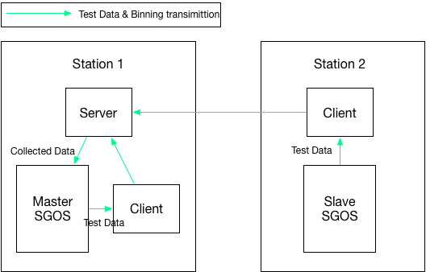
Interactive Flow
Test Data, Binning Summary transmission

Slide 6
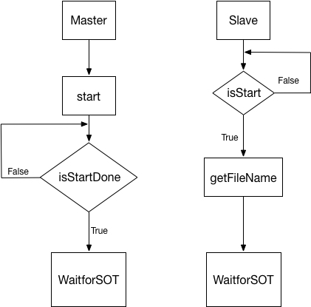
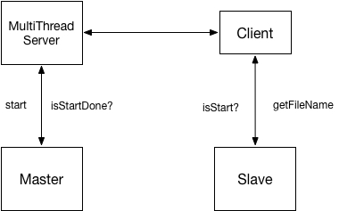
Interactive Flow – Control Signal
start, isStart, getFilename, isStartDone

Slide 7
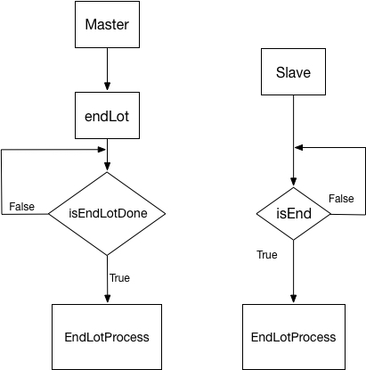
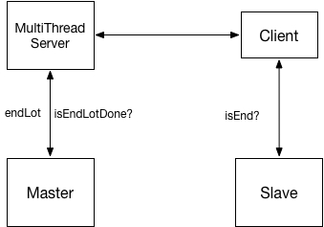
Interactive Flow – Control Signal
endLot, isEnd, isEndDone

Slide 8
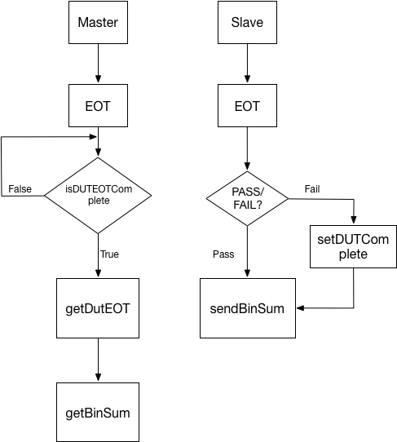
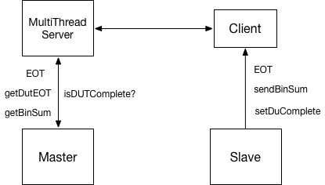
Interactive Flow – Data Transition
isDUTEOTComplete, EOT, getDutEOT, sendBinSum, getBinSum, setDUTComplete

Slide 9
SG9000II.ini
[Tester]
Name=TSG01
OSVer=V1.17
OSVerControl=V1.17.0.0030
Interface=Engineer
SetupPW=OFF
HWScan=OFF
SocketControl=OFF
SecretEng=OFF
MultiStationNo=1
Add “MultiStationNo” into SG9000II.ini to tell SGOS it’s which station.
MultiStationNo 1 means Master, larger than 1 means slave (station x) and 0 means not multistation mode.
It’s better to set master as the last station on handler.

Slide 10
Project TAB file
TestID | UserFunction | TestItem | StopOnFail | PAT | MultiStation
10 | Default | interface_test_Bin1 | 0 | 0 | 2
20 | Default | interface_test_Bin2 | 0 | 0 | 2
30 | Default | interface_test_Bin3 | 0 | 0 | 2
40 | Default | interface_test_Bin4 | 0 | 0 | 2
50 | Default | interface_test_Bin5 | 0 | 0 | 1
60 | Default | interface_test_Bin6 | 0 | 0 | 1
70 | Default | interface_test_Bin7 | 0 | 0 | 1
Notes:
Table file在PAT欄位後增加一表示MultiStation的欄位, 標示每一TestItem屬於那一station

Slide 11
Setup Environment
1. Install Python 2.7.x
2. Replace the header files: object.h, pyconfig.h to \Python27\Include\
by the ones in “RequireFilesForBCB”.
3. Replace the python27.lib in \Pytho27\libs\ by the python27_OMF.lib in “RequireFilesForBCB”
4. Setup the ini file by the instruction attached PDF file.
5. The server and client python program must put in the directory named: c:\sigurd\
安裝設定文件:
Notes:
RequireFilesForBCB目錄在 MultiStationServerPython資料庫中, 可從SCM Server上取得

Slide 12
Multi_thread_socket_server_config.ini
[MultiThreadServer]
intListeningPort = 8888
[Client]
lstClientIP = 192.168.23.51, 192.168.23.83
Station 2
Station 1
Notes:
Station 1 代表Master 的IP必須放在最後面, 之前皆為 slave

Slide 13
sendMsg
在BCB中想透過python的client程式傳送指令給Server, 可透過以下sendMsg 函式
//將Python環境在C++下啟動
Py_Initialize();
AnsiString strReturnMsg;
char strDut[8];
//sendMsg(“SendSocketClient”, “sendMsg”, 指令, 第幾顆IC, 傳送資料)
strReturnMsg = sendMsg("SendSocketClient", "sendMsg", "isDutEOTComplete", strDut, "");

Slide 14
sendMsg
AnsiString __fastcall sendMsg(char* strModule, char* strFunction, char* strStyle, char* strDut, char* strMessage) {
AnsiString strResult;
PyObject *pName, *pModule, *pFunc,*pArgs, *pValue;
pName = PyString_FromString(strModule);
pModule = PyImport_Import(pName);
Py_DECREF(pName);
if (pModule != NULL) {
pFunc = PyObject_GetAttrString(pModule, strFunction);
if (pFunc && PyCallable_Check(pFunc)) {
pArgs = PyTuple_Pack(3, PyString_FromString(strStyle),
PyString_FromString(strDut), PyString_FromString(strMessage));
pValue = PyObject_CallObject(pFunc, pArgs);
if (pValue == NULL) {
return "Exception Error";
}
strResult = AnsiString(PyString_AsString(pValue));
Py_DECREF(pArgs);
if (pValue != NULL) {
} else {
PyErr_Print();
strResult= "Error";
}
Py_XDECREF(pValue);
Py_XDECREF(pFunc);
Py_DECREF(pModule);
return strResult;
}
Py_XDECREF(pFunc);
Py_DECREF(pModule);
return "Error";
} else {
PyErr_Print();
return "Error";
}
Py_DECREF(pModule);
return "Error";
}

